Slide 1
統計學一上 Chapter 2: Graphical Descriptive Techniques I
Sep. 21, 2016
By
Ching-Chin Chern

Slide 2
Introduction & Re-cap…
Descriptive statistics involves arranging, summarizing, and presenting a set of data in such a way that useful information is produced.
Descriptive Statistics
Data
Information

Slide 3
Populations & Samples
Population
Sample
Subset
Parameter
Statistic
The graphical & tabular methods presented here apply to both entire populations and samples drawn from populations.

Slide 4
Descriptive Statistics
Methods or techniques involves the arrangement, summary, and presentation of data, to enable meaningful interpretation, and to support decision making.

Slide 5
Descriptive Statistics Methods
Graphical techniques
Numerical descriptive measures.
The methods presented apply to both the entire population and the sample

Slide 6
Agenda
Type of Data and information
Describing a Set of Nominal Data
Describing the Relationship between Two Nominal Variables

Slide 7
Variables
Characteristics of population or sample that is of interest for us.
Typically denoted with a capital letter: X, Y, Z…
X = Mobile phone carrier choice
Y = Student grade
Z = The patient’s waiting time for a medical service

Slide 8
Value
The values of the variable are the range of possible values for a variable.
X = Mobile phone carrier choice =“台灣大哥大”, “中華電信,”…
Y = Student grade: A, B, C, F
Z = The patient’s waiting time for a medical service: 0~60 minutes

Slide 9
Data
The observed values of a variable (x₁, x₂, …)
Mobile phone carrier choices: {“台灣大哥大”, “中華電信”, “遠傳”,…}
Student grades: {C, C, B, A, F, F,…}
The patient’s waiting time for a medical service: {30, 18, 5, 7, …} minutes

Slide 10
Types of Data (Value)
Nominal data are qualitative or categorical observations
Ordinal data are ordered categorical observations
Interval data are quantitative or numerical observations

Slide 11
Type of Data & Information
Data
Categorical?
N
Interval Data
Y
Ordered?
Y
Ordinal Data
Categorical Data
N
Nominal Data

Slide 12
Student Grade
Data
Categorical?
N
Interval Data
e.g. {0..100}
Y
Ordered?
Y
Ordinal Data
e.g. {F, D, C, B, A}
Categorical Data
Rank order to data
N
Nominal Data
e.g. {Pass | Fail}
No rank order to data

Slide 13
Type of Data - Examples
Interval data
Nominal
Person Marital status
1 married
2 single
3 single
. .
. .
Age - income
55 75000
42 68000
. .
. .
Knowing the type of data is necessary to properly select the technique to be used.
Computer Brand
1 Mac
2 Dell
3 Mac
. .
. .
Weight gain
+10
+5
.
.

Slide 14
Calculations for Data
All calculations are permitted on interval data.
Only calculations involving a ranking process are allowed for ordinal data.
No calculations are allowed for nominal (ordinal) data, save counting the number of observations in each category.

Slide 15
Types of Data - Examples
Interval data
Nominal data
Computer Brand
1 Mac
2 Dell
3 Mac
. .
. .
Age - income
55 75000
42 68000
. .
. .
With nominal data, all we can do is to calculate the proportion of data that falls into each category.
Average Age = 33 Average Income = 45300
Age - Avg income
0-20 20000
21-30 35000
. .
. .
Average Age = 37.5 Average Income = 38200
Mac Dell HP Other Total
25 11 8 6 50
50% 22% 16% 12% 100%

Slide 16
Agenda
Type of Data and Information
Describing a Set of Nominal Data
Describing the Relationship between Two Nominal Variables

Slide 17
Analysis for Nominal data
The only allowable calculation on nominal data is to count the frequency of each value of a variable and compute the proportion

Slide 18
Relative Frequency
Category Relative
Frequency
Category Frequency
=
Total Number
of Observations
It is often preferable to show the relative frequency (proportion) of observations falling into each category, rather than the frequency itself.

Slide 19
Graphical Techniques for Nominal (Ordinal) Data
Collect data
Count frequency for each category
Compute relative frequency (proportion) for each category

Slide 20
Graphical Techniques for Nominal data
When the raw data can be naturally categorized in a meaningful manner, we can display frequencies (Proportion) by
Pie chart
Bar chart

Slide 21
Pie Charts
A very popular tool used to represent the proportions (relative frequency distributions) of appearance for nominal data.
Emphasize the proportion of occurrences of each category.

Slide 22
Drawing a Pie Chart
First draw a circle; then use the relative frequencies to divide the circle into sectors that correspond to the relative frequency for each class.
Since there are 360 degrees in a circle, a class with a relative frequency of .25 would consume .25(360) = 90 degrees of the circle.

Slide 23
Example
The student placement office at a university wanted to determine the general areas of employment last year. Data was collected, and the count of the occurrences was recorded for each area. These counts were converted to proportions and the results were presented in a pie chart.

Slide 24
Frequency and Proportion
Major | Frequency | Relative Frequency (Proportion)
Accounting | 73 | 28.9%
Finance | 52 | 20.6%
General Management | 36 | 14.2%
Marketing | 64 | 25.3%
Other | 28 | 11.1%
Total | 253 | 100%
/253 =
/253 =
/253 =
/253 =
/253 =

Slide 25
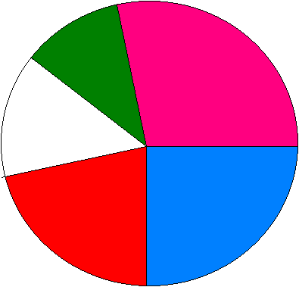
Pie Chart
Other
11.1%
Accounting
28.9%
(28.9 /100)*
(360⁰)
= 104⁰
General
Management
14.2%
Marketing
25.3%
Finance
20.6%

Slide 26
Insights Gained from the Preceding Pie Chart
The largest employment area is Accounting, followed by Marketing, then Finance.
These there area have almost 75% of the total employment
Other
11.1%
Accounting
28.9%
General
Management
14.2%
Finance
20.6%
Marketing
25.3%

Slide 27
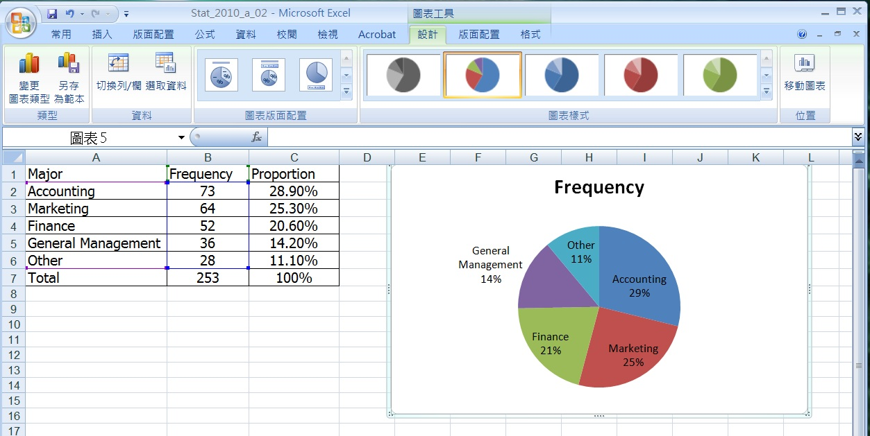
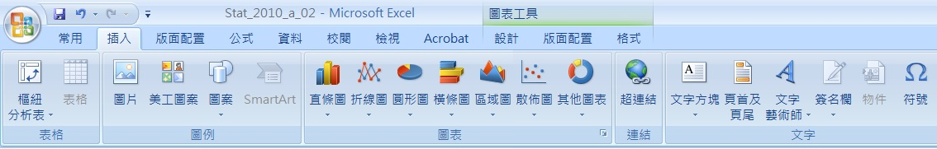
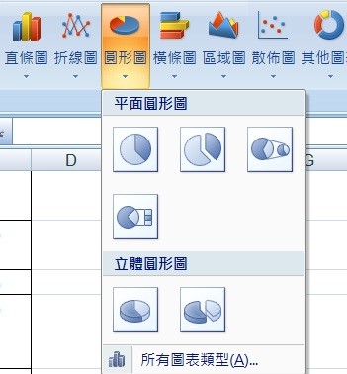
Excel Output

Slide 28
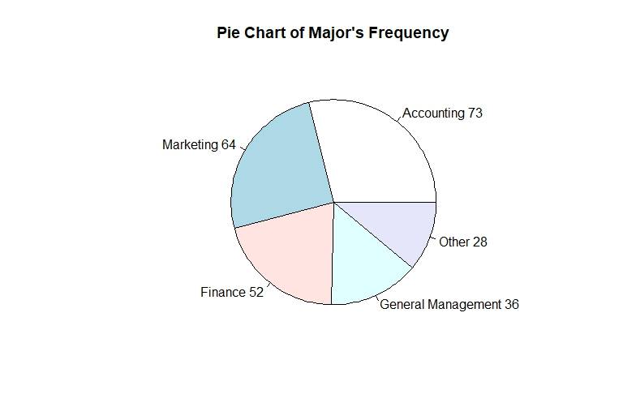
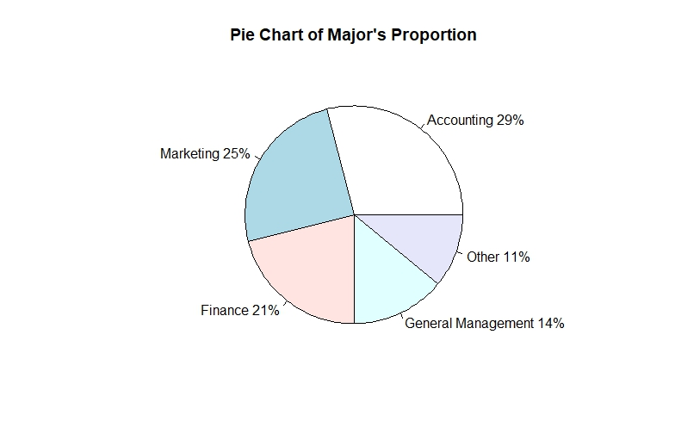
R Code for Pie Chart
fileXls = "Major_frq.xlsx"
DS_data <- loadWorkbook(fileXls)
Major_File <- readWorksheet(DS_data,1)
Major <- Major_File$Major
Frequency <- Major_File$Frequency
n <- length(Major)
Major_F <- paste(Major, Frequency) # add Frequency to label
pie(Frequency, labels = Major_F, main="Pie Chart of Major's Frequency")
pct <- round(Frequency/sum(Frequency)*100)
Major_P <- paste(Major, pct) # add percents to labels
Major_P <- paste(Major_P,"%",sep="") # ad % to labels
pie(pct, labels = Major_P, main="Pie Chart of Major's Proportion")
library(rJava)
library(XLConnect)
library(lmtest)
library(tseries)
library(snpar)
library(vcd)
library(MASS)

Slide 29
Example: Marada Inn
The ratings provided by a sample of 20 guests are shown below.
Below Average Average Above Average
Above Average Above Average Above Average
Above Average Below Average Below Average
Average Poor Poor
Above Average Excellent Above Average
Average Above Average Average
Above Average Average

Slide 30
Frequency and Relative Frequency
Frequency Relative Percent
Rating Frequency Frequency
Poor 2 .10 10
Below Average 3 .15 15
Average 5 .25 25
Above Average 9 .45 45
Excellent 1 .05 5
Total 20 1.00 100

Slide 31
Pie Chart
Exc.
5%
Poor
10%
Below
Average
15%
Above
Average
45%
Average
25%
Quality Ratings

Slide 32
Insights Gained from the Preceding Pie Chart 1/2
One-half of the customers surveyed gave Marada a quality rating of “above average” or “excellent” (looking at the left side of the pie). This might please the manager.
Exc.
5%
Poor
10%
Below
Average
15%
Above
Average
45%
Average
25%

Slide 33
Insights Gained from the Preceding Pie Chart 2/2
For each customer who gave an “excellent” rating, there were two customers who gave a “poor” rating (looking at the top of the pie). This should displease the manager.
Exc.
5%
Poor
10%
Below
Average
15%
Above
Average
45%
Average
25%

Slide 34
Bar Charts
A graphical device for depicting qualitative data that have been summarized in a frequency, relative frequency, or percent frequency distribution.
The frequency (or relative frequency) of each category is represented by a vertical bar.

Slide 35
Drawing a Bar Graph 1/2
On the horizontal axis we specify the labels that are used for each of the classes.
A frequency, relative frequency, or percent frequency scale can be used for the vertical axis.

Slide 36
Drawing Bar Graph 2/2
Using a bar of fixed width drawn above each class label, we extend the height appropriately.
The bars are separated to emphasize the fact that each class is a separate category.

Slide 37
Example
The student placement office at a university wanted to determine the general areas of employment last year. Data was collected, and the count of the occurrences was recorded for each area. These counts were converted to proportions and the results were presented in a bar chart.

Slide 38
Frequency and Proportion
Major | Frequency | Proportion
Accounting | 73 | 28.9%
Finance | 52 | 20.6%
General Management | 36 | 14.2%
Marketing | 64 | 25.3%
Other | 28 | 11.1%
Total | 253 | 100%

Slide 39
Bar Chart
Frequency vs. Proportion

Slide 40
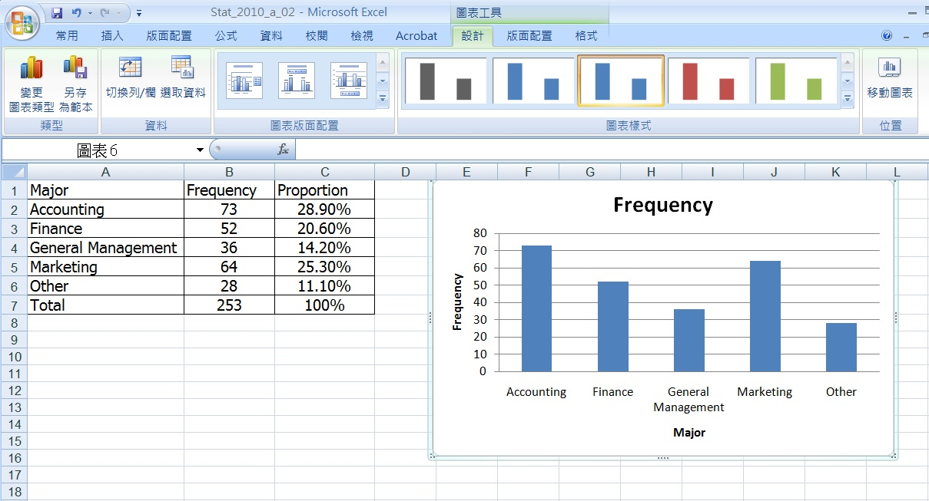
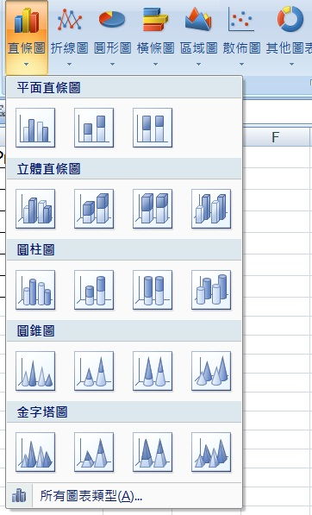
Excel Output

Slide 41
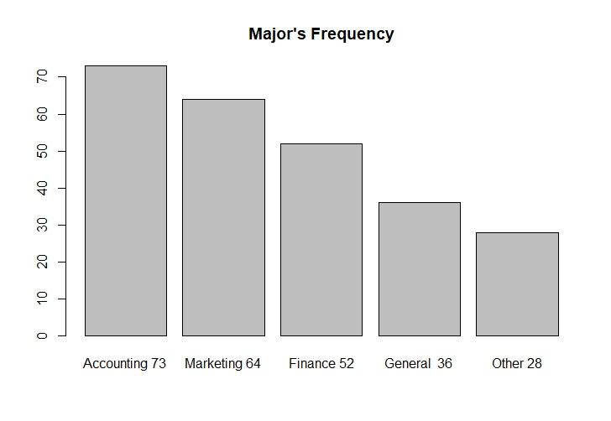
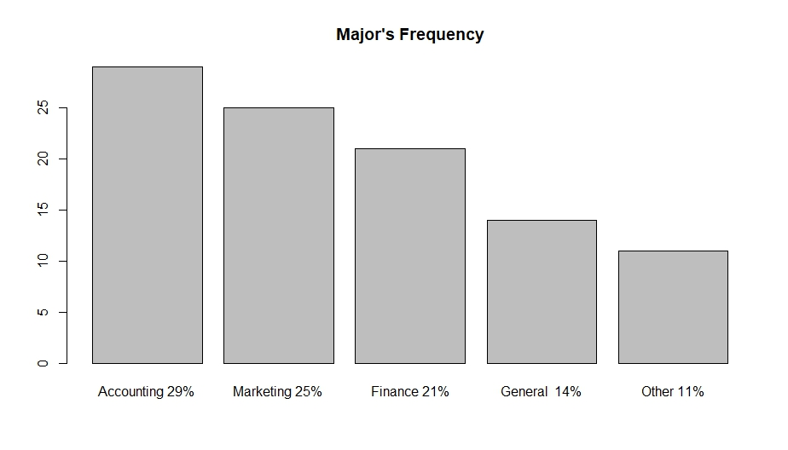
R Code for Bar Chart
fileXls = "Major_frq.xlsx"
DS_data <- loadWorkbook(fileXls)
Major_File <- readWorksheet(DS_data,1)
Major <- Major_File$Major
Frequency <- Major_File$Frequency
n <- length(Major)
Major_F <- paste(Major, Frequency) # add Frequency to label
barplot(Frequency, main="Major's Frequency", names.arg = Major_F)
pct <- round(Frequency/sum(Frequency)*100)
Major_P <- paste(Major, pct) # add percents to labels
Major_P <- paste(Major_P,"%",sep="") # ad % to labels
barplot(pct, main="Major's Frequency", names.arg = Major_P)
library(rJava)
library(XLConnect)
library(lmtest)
library(tseries)
library(snpar)
library(vcd)
library(MASS)

Slide 42
The Bar Chart
Use bar charts also when the order in which nominal data are presented is meaningful.
Total number of new products introduced in North America in the years 1989,…,1994
20,000
15,000
10,000
5,000
0
‘89 ‘90 ‘91 ‘92 ‘93 ‘94

Slide 43
Analysis for Nominal data
Count the frequency of each value of a variable
Compute the relative frequency (proportion)
Pie chart
Bar chart

Slide 44
Example: Light Beer Preference Survey
In 2006 total light beer sales in the United States was approximately 3 million gallons. With this large a market breweries often need to know more about who is buying their product.

Slide 45
Sampling
The marketing manager of a major brewery wanted to analyze the light beer sales among college and university students who do drink light beer. A random sample of 285 graduating students was asked to report which of the following is their favorite light beer.

Slide 46
Different Brands
The responses were recorded using the codes. Construct a frequency and relative frequency distribution for these data and graphically summarize the data by producing a bar chart and a pie chart.
1. Budweiser Light
2. Busch Light
3. Coors Light
4. Michelob Light
5. Miller Lite
6. Natural Light
7. Other brand

Slide 47
Data

Slide 48
Frequency and Relative Frequency Distributions
Code | Light Beer Brand | Frequency | Relative Frequency
1 | Budweiser Light | 90 | 31.58 %
2 | Busch Light | 19 | 6.67 %
3 | Coors Light | 62 | 21.75 %
4 | Michelob Light | 13 | 4.56 %
5 | Miller Lite | 59 | 20.70 %
6 | Natural Light | 25 | 8.77 %
7 | Other brands | 17 | 5.96 %
 | Total | 285 | 100 %

Slide 49
Nominal Data (Frequency)
Bar Charts are often used to display frequencies…

Slide 50
Nominal Data (Relative Frequency)
Pie Charts show relative frequencies…

Slide 51
Nominal Data
All the same information, (based on the same data). Just different presentation.

Slide 52
Agenda
Type of Data and information
Describing a Set of Nominal Data
Describing the Relationship between Two Nominal Variables

Slide 53
Contingency Table (列聯表)
Also called a cross-classification table or cross-tabulation table
To describe the relationship between two nominal variables.
Lists the frequency of each combination of the values of the two variables

Slide 54
Two Nominal Variables
Create a contingency table, listing the frequency for each combination of values of the two variables.
Create a bar chart that represent the frequency of occurrence of each combination of values.

Slide 55
Example
To conduct an efficient advertisement campaign the relationship between occupation and newspapers readership is studied.

Slide 56
Data
A sample of newspaper readers was asked to report which newspaper they read: Globe and Mail (1), Post (2), Star (3), or Sun (4), and to indicate whether they were blue-collar worker (1), white-collar worker (2), or professional (3).

Slide 57
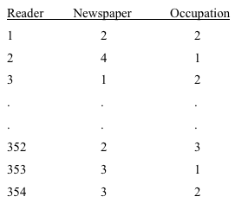
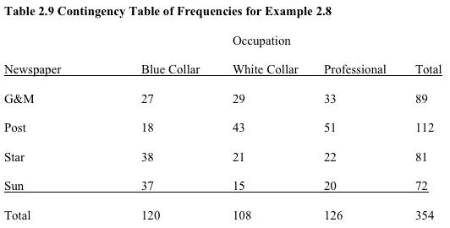
Contingency Table
This reader’s response is captured as part of the total number on the contingency table…

Slide 58
Analysis
If there is no relationship between occupation and newspaper read, the bar charts describing the frequency of readership of newspapers should look similar across occupations.

Slide 59
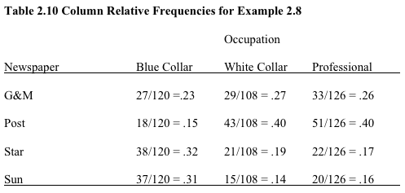
Interpretation 1/2
The relative frequencies in the columns 2 & 3 are similar, but there are large differences between columns 1 and 2 and between columns 1 and 3.
similar
dissimilar

Slide 60
Interpretation 2/2
This tells us that blue collar workers tend to read different newspapers from both white collar workers and professionals and that white collar and professionals are quite similar in their newspaper choice.

Slide 61
Bar Chart—Occupation 1/2
Professionals and White Collars tend to read the Post more than twice as often as the Star or Sun…

Slide 62
Bar Chart—Occupation 2/2
Blue-collar workers prefer the “Star” and the “Sun”.
White-collar workers and professionals mostly read the “Post” and the “Globe and Mail”

Slide 63
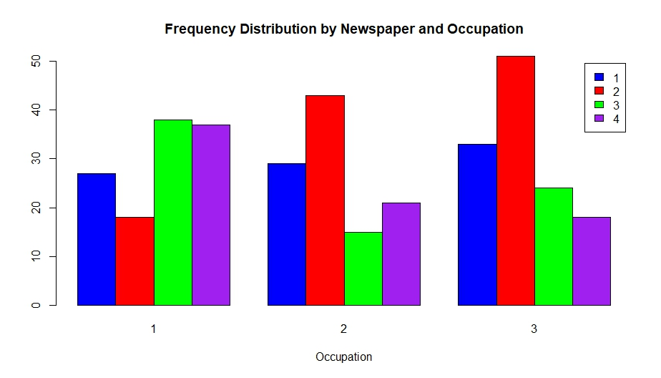
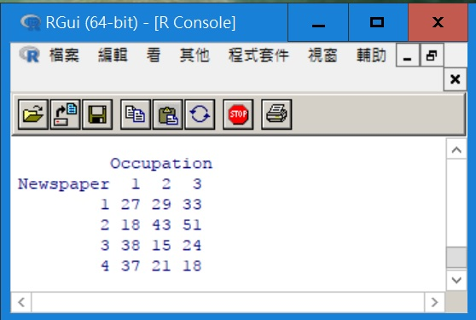
R Code for Bar Chart
fileXls = "Newspaper_occupation.xlsx"
NC_data <- loadWorkbook(fileXls)
News_Occ <- readWorksheet(NC_data,1)
Newspaper <- News_Occ$Newspaper
Occupation <- News_Occ$Occupation
n <- length(Newspaper)
mytable <- table(Newspaper,Occupation)
barplot(mytable, main="Frequency Distribution by Newspaper and Occupation", xlab="Occupation", col = c("blue", "red", "green", "purple"), legend = rownames(mytable), beside=TRUE)
library(rJava)
library(XLConnect)
library(lmtest)
library(tseries)
library(snpar)
library(vcd)
library(MASS)

Slide 64
End of Chapter 2

Slide 65
Chapter 3: Graphical Descriptive Techniques II

Slide 66
Agenda
Techniques to Describe a Set of Interval Data
Describing Time-Series Data
Describing the Relationship between Two Interval Variables
Art and Science of Graphical Presentations

Slide 67
Graphical Techniques for Interval Data
Collect data
Prepare a frequency distribution
Draw a Histogram, an Ogive, or a Stem and Leaf Display

Slide 68
Frequency Distribution
An arrangement or table that groups data into non-overlapping intervals called classes and records the number of observations in each class.

Slide 69
Steps of Constructing the Frequency Distribution
Determine # of classes
Compute class width
Determine the upper and lower bounds of each class
Count the frequencies for each class

Slide 70
Example
Providing information concerning the monthly bills of new subscribers in the first month after signing on with a telephone company.

Slide 71
Providing Information
Prepare a frequency distribution
Collect data
How many classes to use?
Number of observations Number of classes
< 50 5-7
50 - 200 7-9
200 - 500 9-10
500 - 1,000 10-11
1,000 – 5,000 11-13
5,000- 50,000 13-17
More than 50,000 17-20
=> 8
Class width = [Range] / [# of classes]
[119.63 - 0] / [8] = 14.95 15
There are 200 data points
Largest
observation
Smallest
observation

Slide 72
Constructing the Frequency Distribution
There are 200
data points

Slide 73
Histograms
A Graphical presentation by drawing rectangles
The bases of rectangles correspond to the class intervals
The height of each rectangle equals the number of observations in that class

Slide 74
Histogram and Frequency Distribution
Draw a Histogram

Slide 75
Information from Histogram
About half of all the bills are “small”
A few bills are in the middle range
Relatively, large number of large bills
71+37=108
13+9+10=32
18+28+14=60
80
60
Frequency
(18+28+14=60)÷200 = 30%
i.e. nearly a third of the phone bills are $90 or more.
40
20
0
15
30
45
60
75
90
105
120
Bills

Slide 76
Class Relative Frequency
Class Relative
Frequency
Class Frequency
=
Total Number
of Observations
It is often preferable to show the relative frequency (proportion) of observations falling into each class, rather than the frequency itself.

Slide 77
Example
Providing information concerning the monthly bills of new subscribers in the first month after signing on with a telephone company.

Slide 78
Relative Frequency
71 / 200 = 0.3550

Slide 79
When to Use Relative Frequencies
The population relative frequencies are studied
Comparing two or more histograms
The number of observations of the samples studied are different

Slide 80
Note on Class Width
Generally equal but not necessarily
Unequal class width is used when the frequency associated with some classes is too low.

Slide 81
Unequal Class Width
Several classes are combined together to form a wider and “more populated” class.
It is possible to form an open ended class at the higher end or lower end of the histogram.

Slide 82
Shapes of Histogram
Based on the following characteristics:
Symmetric vs. Skewness
Number of modal classes
Bell Shape

Slide 83
Interpreting Histograms
The final step is to interpret the histograms based on the heights of individual classes or the overall shape.

Slide 84
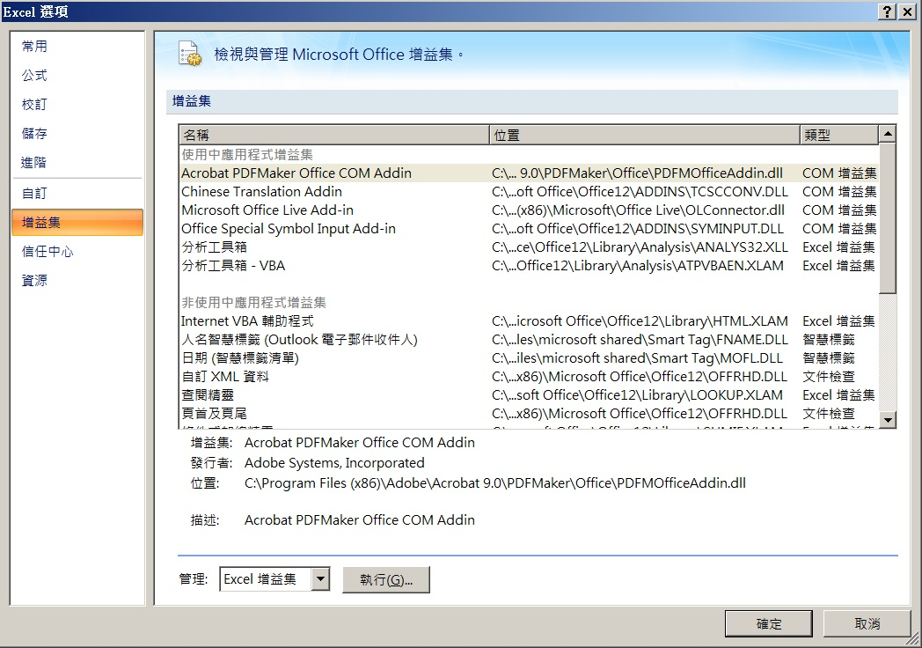
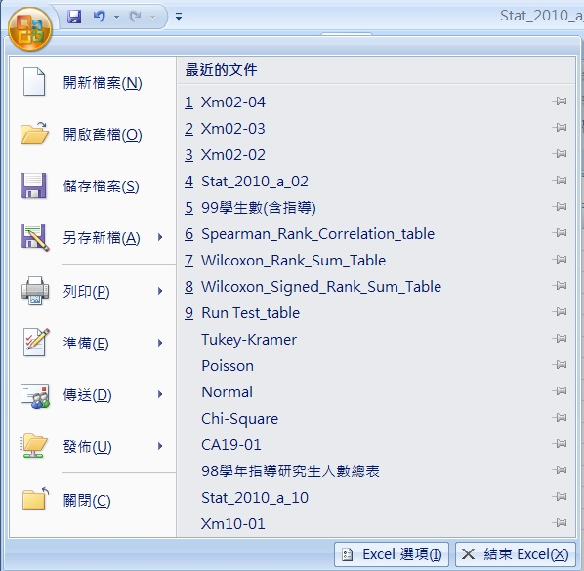
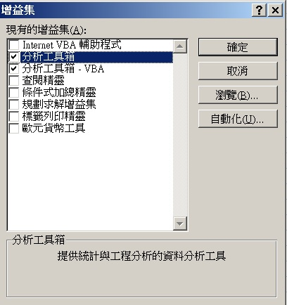
Excel Setup

Slide 85
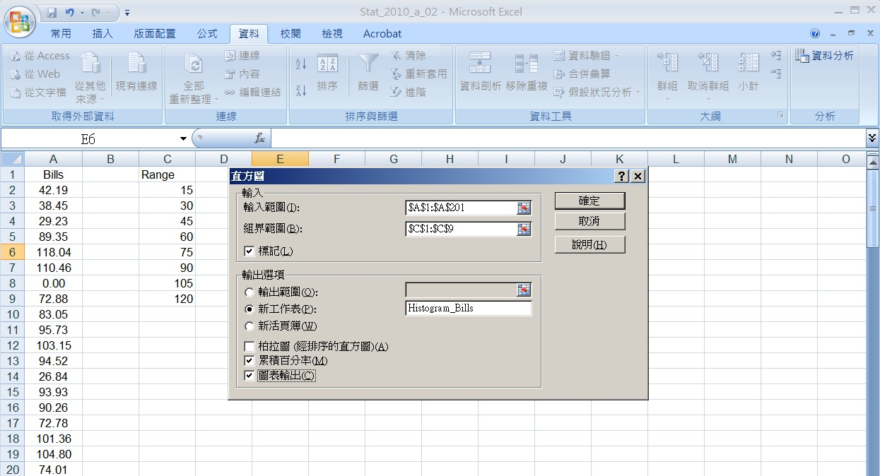
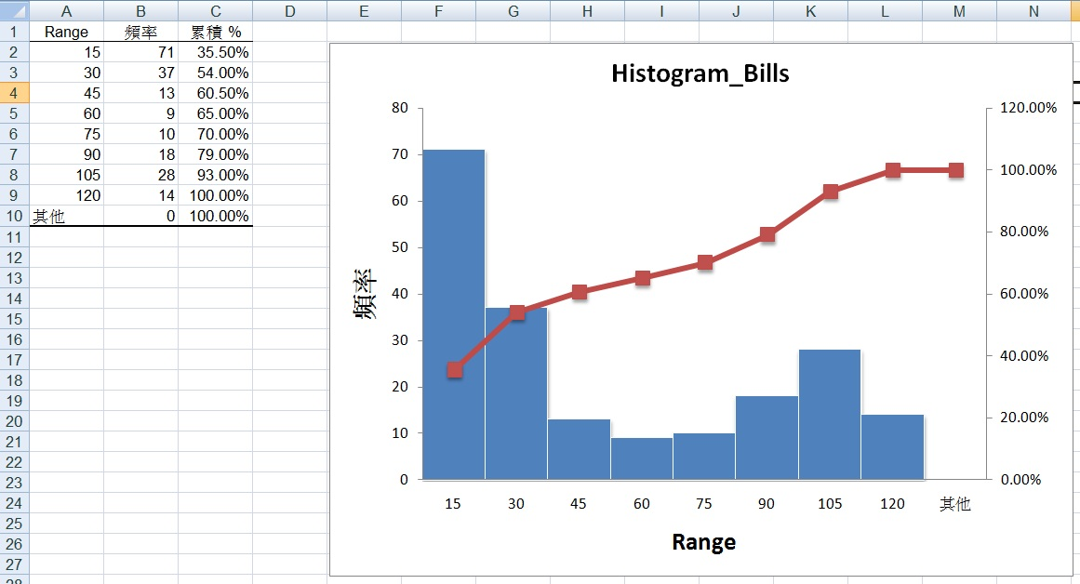
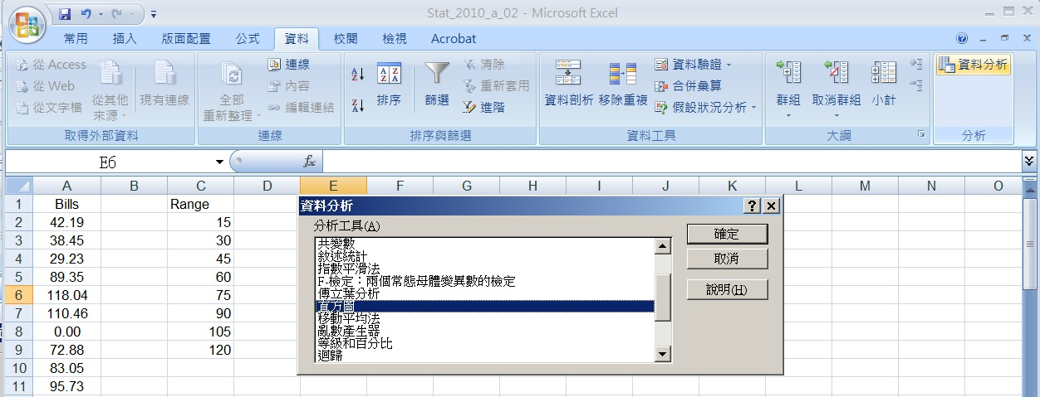
Excel Output

Slide 86
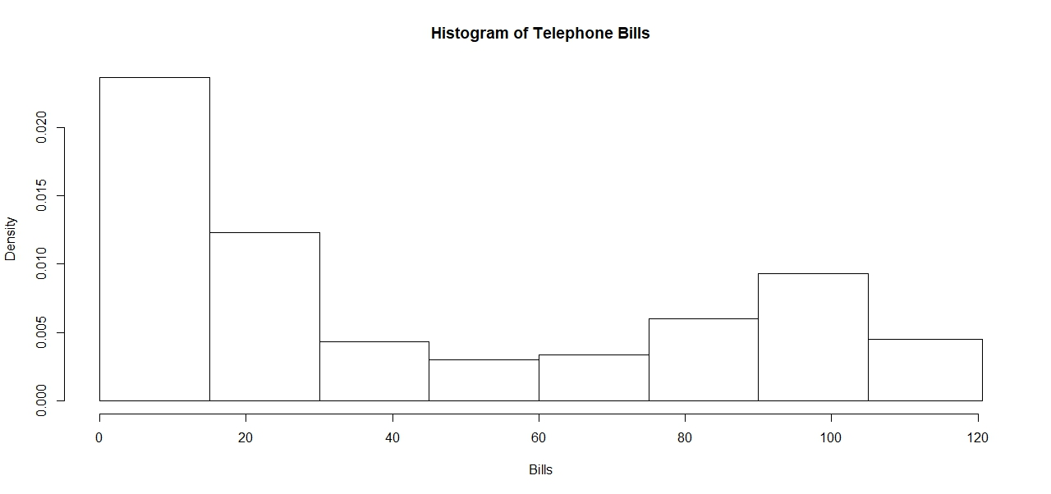
R Code for Histogram
fileXls = "Telephone_bills.xlsx"
TB_data <- loadWorkbook(fileXls)
T_B <- readWorksheet(TB_data,1)
Bills <- T_B$Bills
n <- length(Bills)
break_p <- vector("double", length = 9)
break_p[1] <- 0
size <- length(Bills)
for(j in 2:8) {
break_p[j] <- break_p[j-1] + 15
}
break_p[9] <- max(Bills) + 1
p_HG <- hist(Bills, breaks = break_p, main="Histogram of Telephone Bills")
library(rJava)
library(XLConnect)
library(lmtest)
library(tseries)
library(snpar)
library(vcd)
library(MASS)

Slide 87
Example: Selecting an investment
An investor is considering investing in one out of two investments. The returns on these investments were recorded.

Slide 88
Interpret the Histogram
From the two histograms, how can the investor interpret the:
Expected returns
The spread of the return (the risk involved with each investment)

Slide 89
Interpretation 1/3
18-
16-
14-
12-
10-
8-
6-
4-
2-
0-
The center
for A
18-
16-
14-
12-
10-
8-
6-
4-
2-
0-
The center for B
-15 0 15 30 45 60 75
-15 0 15 30 45 60 75
Return on investment A
Return on investment B
The center of the returns of Investment A is slightly lower than that for Investment B

Slide 90
Interpretation 2/3
18-
16-
14-
12-
10-
8-
6-
4-
2-
0-
Sample size =50
18-
16-
14-
12-
10-
8-
6-
4-
2-
0-
Sample size =50
17
16
34
26
46
43
-15 0 15 30 45 60 75
-15 0 15 30 45 60 75
Return on investment A
Return on investment B
The spread of returns for Investment A is less than that for investment B

Slide 91
Interpretation 3/3
18-
16-
14-
12-
10-
8-
6-
4-
2-
0-
18-
16-
14-
12-
10-
8-
6-
4-
2-
0-
-15 0 15 30 45 60 75
-15 0 15 30 45 60 75
Return on investment A
Return on investment B
Both histograms are slightly positively skewed. There is a possibility of large returns.

Slide 92
Conclusion
Investment A is better:
Its expected return is only slightly below that of investment B
The risk from investing in A is smaller.
The possibility of having a high rate of return exists for both investment.

Slide 93
Example: Comparing Students’ Performance
Students’ performance in two statistics classes were compared, differed in their teaching emphasis:
Class A – mathematical analysis and development of theory.
Class B – applications and computer based analysis.

Slide 94
Interpreting Histograms
The final mark for each student in each course was recorded.
Draw histograms and interpret the results.

Slide 95
Interpretation
- Class A
The mathematical emphasis creates two groups, and a larger spread.
- Class B
Allows non-mathematical inclined students learning as well as mathematical inclined students

Slide 96
Ogive
(pronounced “Oh-jive”) is a graph of a cumulative frequency distribution. We create an ogive in three steps:
1) Calculate relative frequencies.
2) Calculate cumulative relative frequencies
3) Graph the cumulative relative frequencies

Slide 97
Example: Ogive
}
}
.930
1.000
.790
.650
.700
.540
.605
.355
15
30
45
60
75
90
105
120

Slide 98
Ogive and Histogram
Ogives are Cumulative Relative Frequency Distributions
Ogive

Slide 99
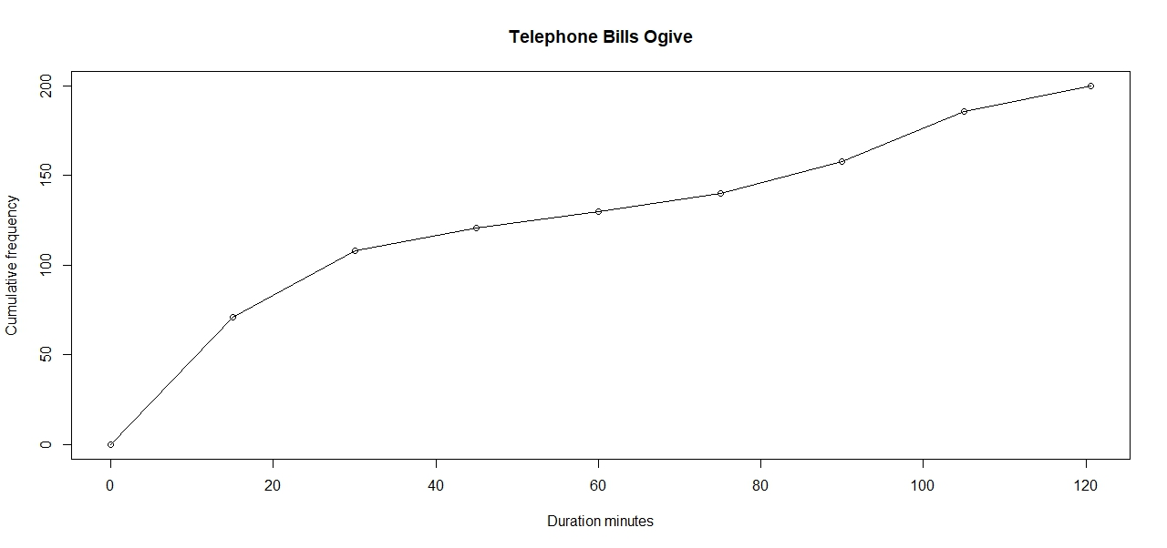
R Code for Ogive
fileXls = "Telephone_bills.xlsx"
TB_data <- loadWorkbook(fileXls)
T_B <- readWorksheet(TB_data,1)
Bills <- T_B$Bills
n <- length(Bills)
break_p <- vector("double", length = 9)
break_p = seq(0, 120, by=15)
Bills.cut = cut(Bills, break_p, right=FALSE)
Bills.freq = table(Bills.cut)
cum_bill_freq0 = c(0, cumsum(Bills.freq))
plot(break_p, cum_bill_freq0, main = "Telephone Bills Ogive", xlab = "Duration minutes", ylab = "Cumulative frequency")
lines(break_p, cum_bill_freq0)
library(rJava)
library(XLConnect)
library(lmtest)
library(tseries)
library(snpar)
library(vcd)
library(MASS)

Slide 100
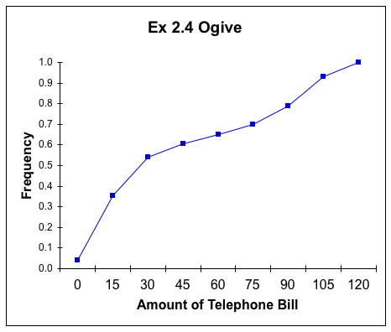
Interpretation
The ogive can be used to answer questions like:
What telephone bill value is at the 50th percentile?
“around $35”
0 15 30 45 60 75 90 105 120

Slide 101
Stem and Leaf Display
This is a graphical technique most often used in a preliminary analysis.
Stem and leaf diagrams use the actual value of the original observations (whereas, the histogram does not).

Slide 102
Constructing a Stem and Leaf Display
Determine what constitutes a stem and a leaf
List the stems in a column from smallest to largest.
Place each leaf at the same row as its stem from smallest to largest.

Slide 103
Conclusion
The observations range from 17.2 to 22.2
Most of the observations fall between 18.0 and 20.0
The shape of the distribution is not symmetrical
Half the observations are below 19.5 and half above it
The complete display is:
Stem Leaf
17 236
18 0144577
19 1123567789
20 038
21 01224
22 12

Slide 104
Other Ways of Determining Stem and Leaf
Split each observation into two parts.
42.19
42.19
Observation:
Stem Leaf 42 19
Stem Leaf
4 2
A stem and leaf display for the next Example will use this method next.

Slide 105
Example
Providing information concerning the monthly bills of new subscribers in the first month after signing on with a telephone company.

Slide 106
Stem and Leaf Display
00000000000111112222223333345555556666666778888999999
1 000001111233333334455555667889999
2 0000111112344666778999
3 001335589
4 124445589
5 33566
6 3458
7 022224556789
8 334457889999
9 00112222233344555999
10 001344446699
11 124557889
The length of each line represents the frequency of the class defined by
the stem.

Slide 107
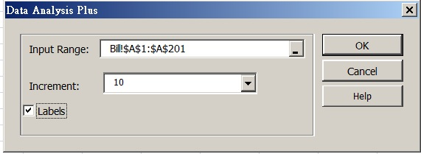
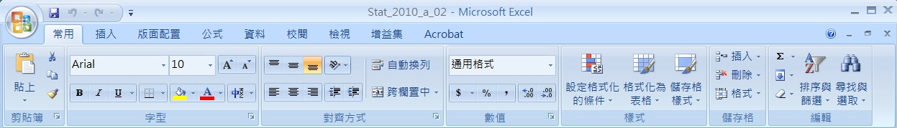
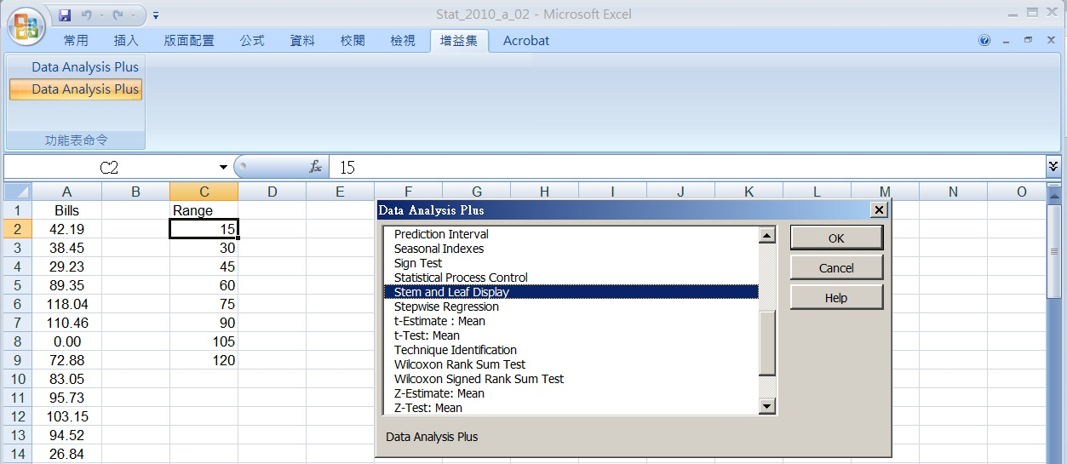
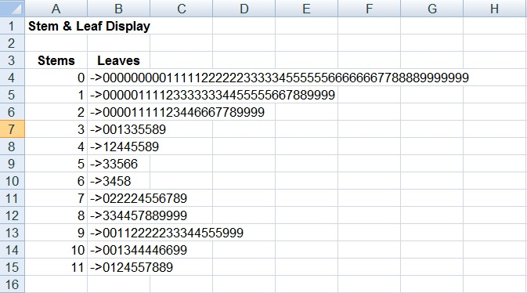
Excel Output

Slide 108
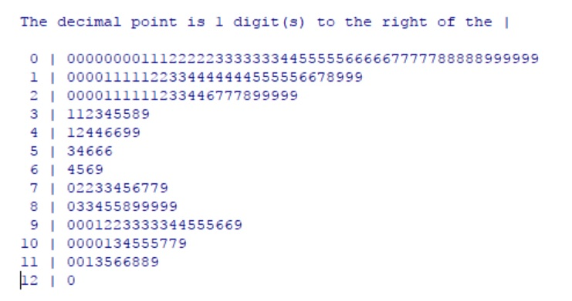
R Code for Stem and Leaf
fileXls = "Telephone_bills.xlsx"
TB_data <- loadWorkbook(fileXls)
T_B <- readWorksheet(TB_data,1)
Bills <- T_B$Bills
n <- length(Bills)
stem(Bills, scale = 1)
library(rJava)
library(XLConnect)
library(lmtest)
library(tseries)
library(snpar)
library(vcd)
library(MASS)

Slide 109
End of Chapter 3 Part A

Slide 110
Homework
Chapter 2:
2.3, 2.7
2.15, 2.23
2.43, 2.47
Chapter 3:
3.7, 3.11

Slide 111
Nominal Data (標籤資料)
Data are labels or names used to identify an attribute of the element.
A nonnumeric label or a numeric code may be used.

Slide 112
Nominal Code
Responses to questions about marital status, coded as: Single = 1, Married = 2, Divorced = 3, Widowed = 4
Because the numbers are arbitrary, arithmetic operations don’t make any sense (e.g. Does Widowed ÷ 2 = Married?!)

Slide 113
Example: Nominal
Population: NTU Students
Variable (X) = Mobile phone carrier choice
Value of X = “台灣大哥大”; “中華電信”; “遠傳”; or “台灣之星”.
Data (x₁, x₂, x₃ , x₄, x₅, x₆) = {“台灣大哥大”, “中華電信”, “遠傳”, “中華電信”, “台灣之星”, “台灣大哥大”}

Slide 114
Example 2
Students of a university are classified by the school in which they are enrolled using a nonnumeric label such as Business, Humanities, Education, and so on. Alternatively, a numeric code could be used for the school variable (e.g. 1 denotes Business, 2 denotes Humanities, 3 denotes Education, and so on).

Slide 115
Ordinal Data (序位資料)
The data have the properties of nominal data and the order or rank of the data is meaningful.
A nonnumeric label or a numeric code may be used.

Slide 116
Ordinal Code
College course rating system: poor = 1, fair = 2, good = 3, very good = 4, excellent = 5 (excellent > poor or fair < very good)
While its still not meaningful to do arithmetic on this data (e.g. Does 2*fair = very good?!),
Order is maintained no matter what numeric values are assigned to each category.

Slide 117
Example: Ordinal
Population: UT Austin Business School Students
Variable (Y) = Student Grade
Value of Y = A, B, C, D, F
Data (y₁, y₂, y₃, y₄, y₅, y₆, y₇, y₈, y₉, y₁₀, y₁₁, y₁₂, y₁₃, y₁₄, y₁₅, y₁₆, y₁₇, y₁₈) = {D, C, C, B, A, F, F, A, B, C, C, D, A, B, B, C, D, D}

Slide 118
Example 2
Students of a university are classified by their class standing using a nonnumeric label such as Freshman, Sophomore, Junior, or Senior. Alternatively, a numeric code could be used for the class standing variable (e.g. 1 denotes Freshman, 2 denotes Sophomore, and so on).

Slide 119
Interval Data (區間資料)
The data have the properties of ordinal data and the interval between observations is expressed in terms of a fixed unit of measure.
Interval data are always numeric.

Slide 120
Interval Code
Real numbers, i.e. heights, weights, prices, times, etc.
Arithmetic operations can be performed on Interval Data, thus its meaningful to talk about 2*Height, or Price + $1, and so on.

Slide 121
Example: Interval
Population: Patients visiting NTU Hospital
Variable (Z) = The patient’s waiting time for a medical service
Value of Z = 0~60 minutes
Data (z₁, z₂, z₃, z₄, z₅, z₆, z₇ , z₈, z₉, z₁₀, z₁₁, z₁₂) = {30, 18, 5, 7, 20, 16, 23, 3, 8, 10, 45, 7} minutes

Slide 122
Example 2
SAT Scores
Melissa has an SAT score of 1205, while Kevin has an SAT score of 1090. Melissa scored 115 points more than Kevin.

Slide 123
Choose # of Classes
# of classes depending on # of observations.

Slide 124
Class Width
Let n be # of classes
Let M be the largest value of the observations
Let m be the smallest value of the observations
M - m
Class width ≥
n

Slide 125
Symmetry
Draw a vertical line down the center the histogram, the two sides are identical in shape and size

Slide 126
Three Symmetry Shapes
Symmetry

Slide 127
Skewness
A histogram with a long tail extending to either the right (positively skewed) or left (negatively skewed)

Slide 128
Two Skewed Shapes
Skewness
Positively skewed
Negatively skewed

Slide 129
Number of Modal Classes
A modal class is the one with the largest number of observations.
Unimodal
Multimodal

Slide 130
Unimodal Histogram
A histogram with only one modal class
The modal class

Slide 131
Multimodal Histogram
A histogram with more than one modal class
first modal class
second modal class
A bimodal histogram

Slide 132
Bell Shape
A special type of symmetric unimodal histogram
Many statistical techniques require that the population be bell shaped. Drawing the histogram helps verify the shape of the population in question.

Slide 133
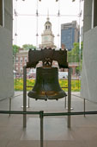



Bell Shaped Histogram

Slide 134
Determine what constitutes a stem and a leaf
From each observation:
The digits to the left of the decimal point is the stem.
The digits to the right of the decimal point is the leaf.

Slide 135
Determining the Stems
Observe the data in the table below
19.1 19.8 18.0 19.2 19.5 17.3 20.0 20.3
19.6 18.5 18.1 19.7 18.4 17.6 21.2 20.6
22.2 19.1 21.1 19.3 20.8 21.2 21.0 18.7
19.9 18.7 22.1 17.2 18.4 21.4
19 . 1
Stem
Leaf

Slide 136
Finding and Sorting All the Stems
19
19
19
18
18
19
19
19
19
17
19
.1
.8
.0
.2
.5
17
.3
19
19
18
19
17
18
17
17
Stem Leaf
19
19
17
19
19
17
18
19
17
19
19
19
18
19
18
19
19
19
19
19
19
19
19

Slide 137
Place All the Leafs
19
.1
19
18
19
19
17
.1
.8
.8
.0
.0
.2
.2
.5
.5
.3
.3
Stem Leaf
19
17
The complete display is:
Stem Leaf
17 623
18 4705147
19 1983627571
20 038
21 12204
22 12
17
3
18
0
.1
19
1
8
2
5

Slide 138
Sorting the Leafs
The complete display is:
Stem Leaf
17 236
18 0144577
19 11235677898
20 038
21 01224
22 12

Slide 139
Example
Providing information concerning the monthly bills of new subscribers in the first month after signing on with a telephone company.

Slide 140
Relative Frequencies

Slide 141
Cumulative Relative Frequencies
Calculate cumulative relative frequencies by adding the current class’ relative frequency to the previous class’ cumulative relative frequency.

Slide 142
Cumulative Relative Frequencies
first class
next class: .355+.185=.540
last class: .930+.070=1.00

